Slide 1
Body Language
By Ahmed Ehab Ahmed

Slide 2
Organizational

Slide 3
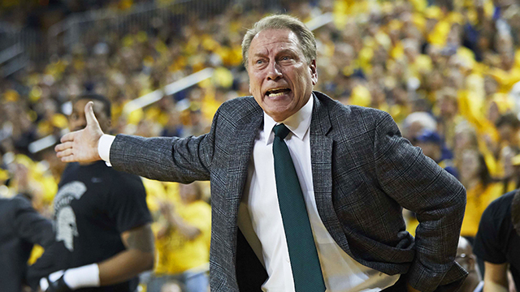

Slide 4
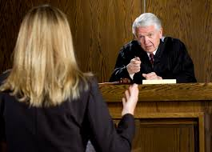

Slide 5
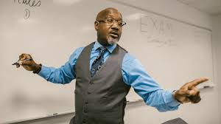

Slide 6
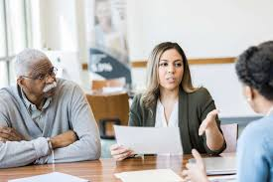

Slide 7
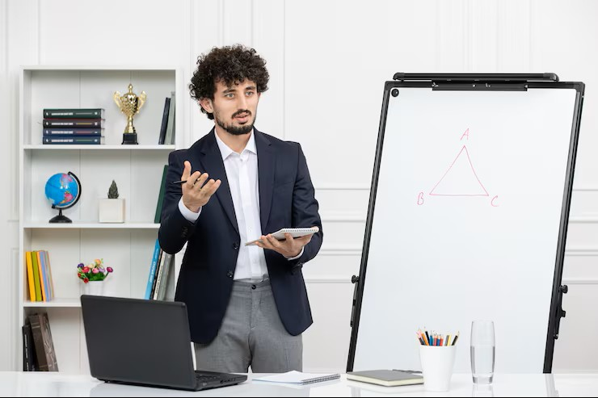

Slide 8
Interpersonal

Slide 9


Slide 10


Slide 11
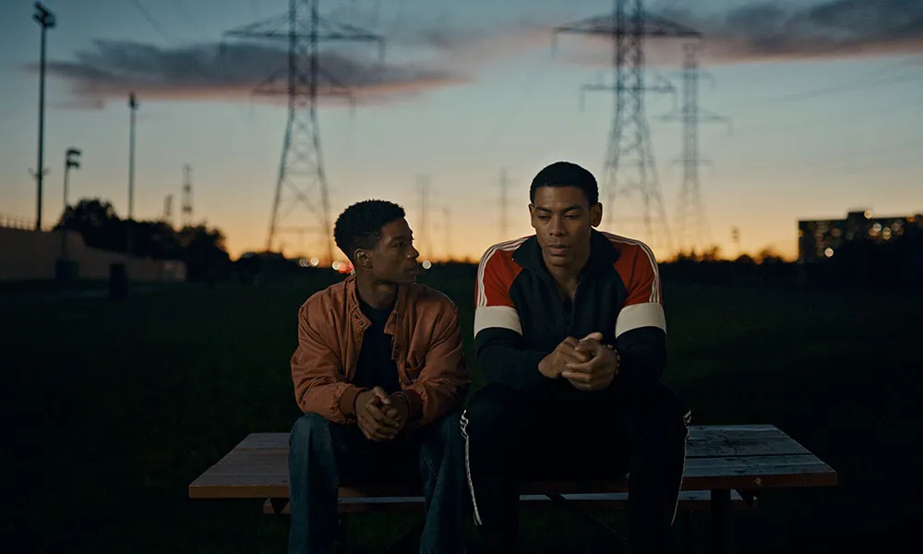

Slide 12
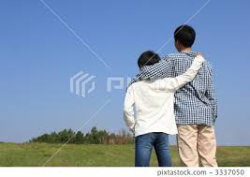

Slide 13
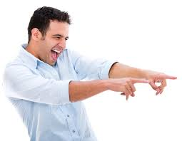

Slide 14
Thank You

